Slide 1
Azure Multi-Region Architectures
What is a multi-region architecture ?
What does it get me ?
Do I need it ?
How do I pull it off ?

Slide 2
Overview
Key concepts
Architecture Approaches
Recovering from a region failure
Related Best Practices
Overview of Global Load Balancer options

Slide 3

Azure
Azure
Global
Region (A)
East US
Availability Zone(s)
1, 2,, 3
Datacenter
Building 1
Region (B)
West US
Geography
North America
Availability Zone(s)
1, 2, 3
Datacenter
Building 1
Datacenter
Building 2
Datacenter
Building 2
Pair

Slide 4
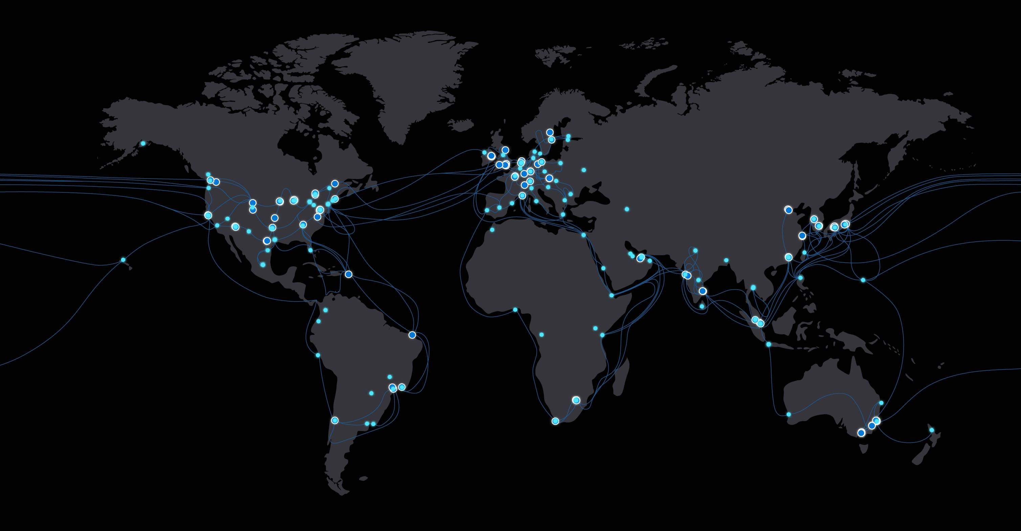
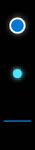
Microsoft global network
Region
Edge
Network
60+
Azure regions
130k+
miles of fiber + subsea cables
160+
edge sites
500+
network partners
20k+
peering connections

Slide 5
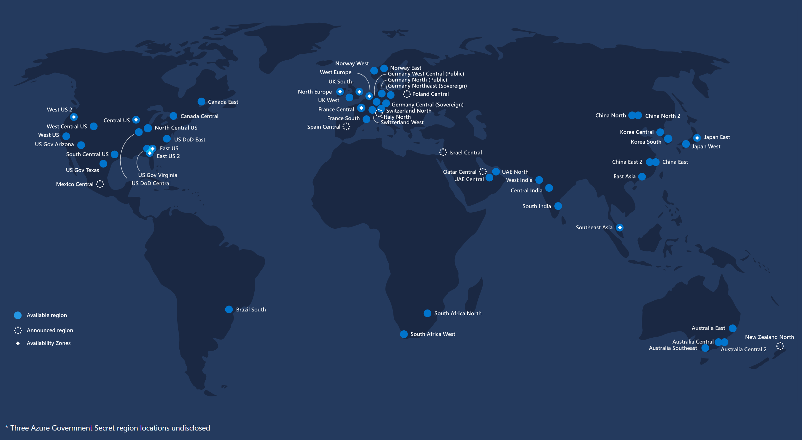
Azure Region Map

Slide 6
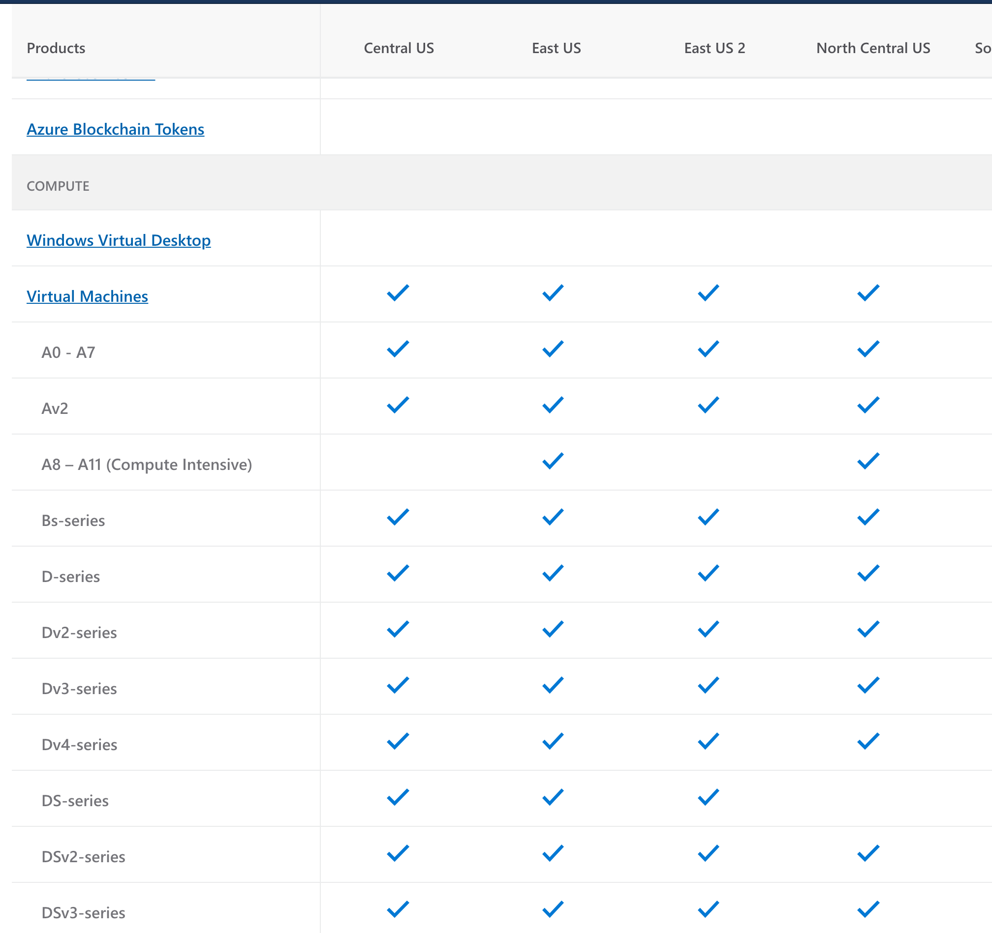
Choosing an Azure Region
Proximity
Compliance and data residency
Service Availability
Region Pairing

Slide 7
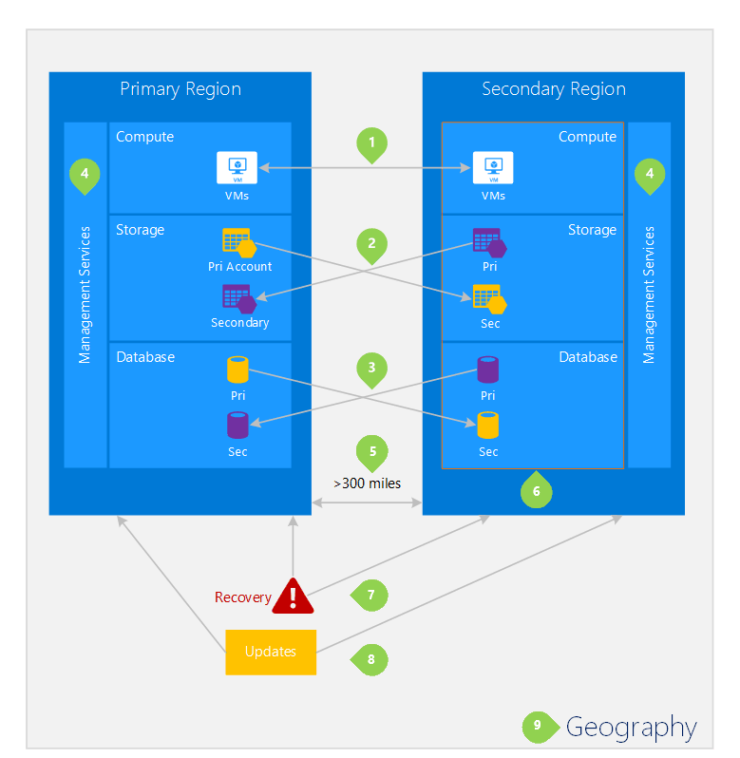
Region Pairs
Physical isolation
Platform-provided replication
Region recovery order
Sequential updates
Data residency
Notes:
Physical isolation – When possible, Azure prefers at least 300 miles of separation between datacenters in a regional pair, although this isn't practical or possible in all geographies. Physical datacenter separation reduces the likelihood of natural disasters, civil unrest, power outages, or physical network outages affecting both regions at once. Isolation is subject to the constraints within the geography (geography size, power/network infrastructure availability, regulations, etc.).
Platform-provided replication - Some services such as Geo-Redundant Storage provide automatic replication to the paired region.
Region recovery order – In the event of a broad outage, recovery of one region is prioritized out of every pair. Applications that are deployed across paired regions are guaranteed to have one of the regions recovered with priority. If an application is deployed across regions that are not paired, recovery might be delayed – in the worst case the chosen regions may be the last two to be recovered.
Sequential updates – Planned Azure system updates are rolled out to paired regions sequentially (not at the same time) to minimize downtime, the effect of bugs, and logical failures in the rare event of a bad update.
Data residency – A region resides within the same geography as its pair (with the exception of Brazil South) to meet data residency requirements for tax and law enforcement jurisdiction purposes.

Slide 8
Region Pairs (partial)
Geography | Pair A | Pair B
North America | East US | West US
North America | East US 2 | Central US
North America | North Central US | South Central US
North America | West US 2 | West Central US
North America | East US | West US
Europe | North Europe (Ireland) | West Europe (Netherlands)
France | France Central | France South
Germany | Germany Central | Germany Northeast
US Government | US Gov Arizona | US Gov Texas
US Government | US Gov Iowa | US Gov Virginia
US Government | US Gov Virginia | US Gov Texas
… | … | …

Slide 9
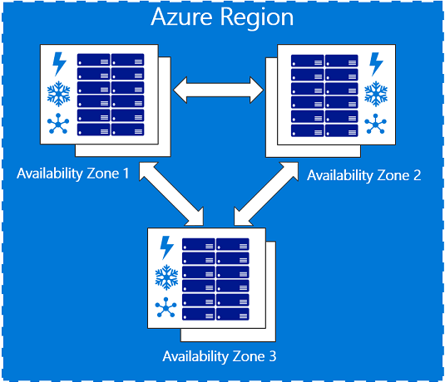
Availability Zones

Slide 10
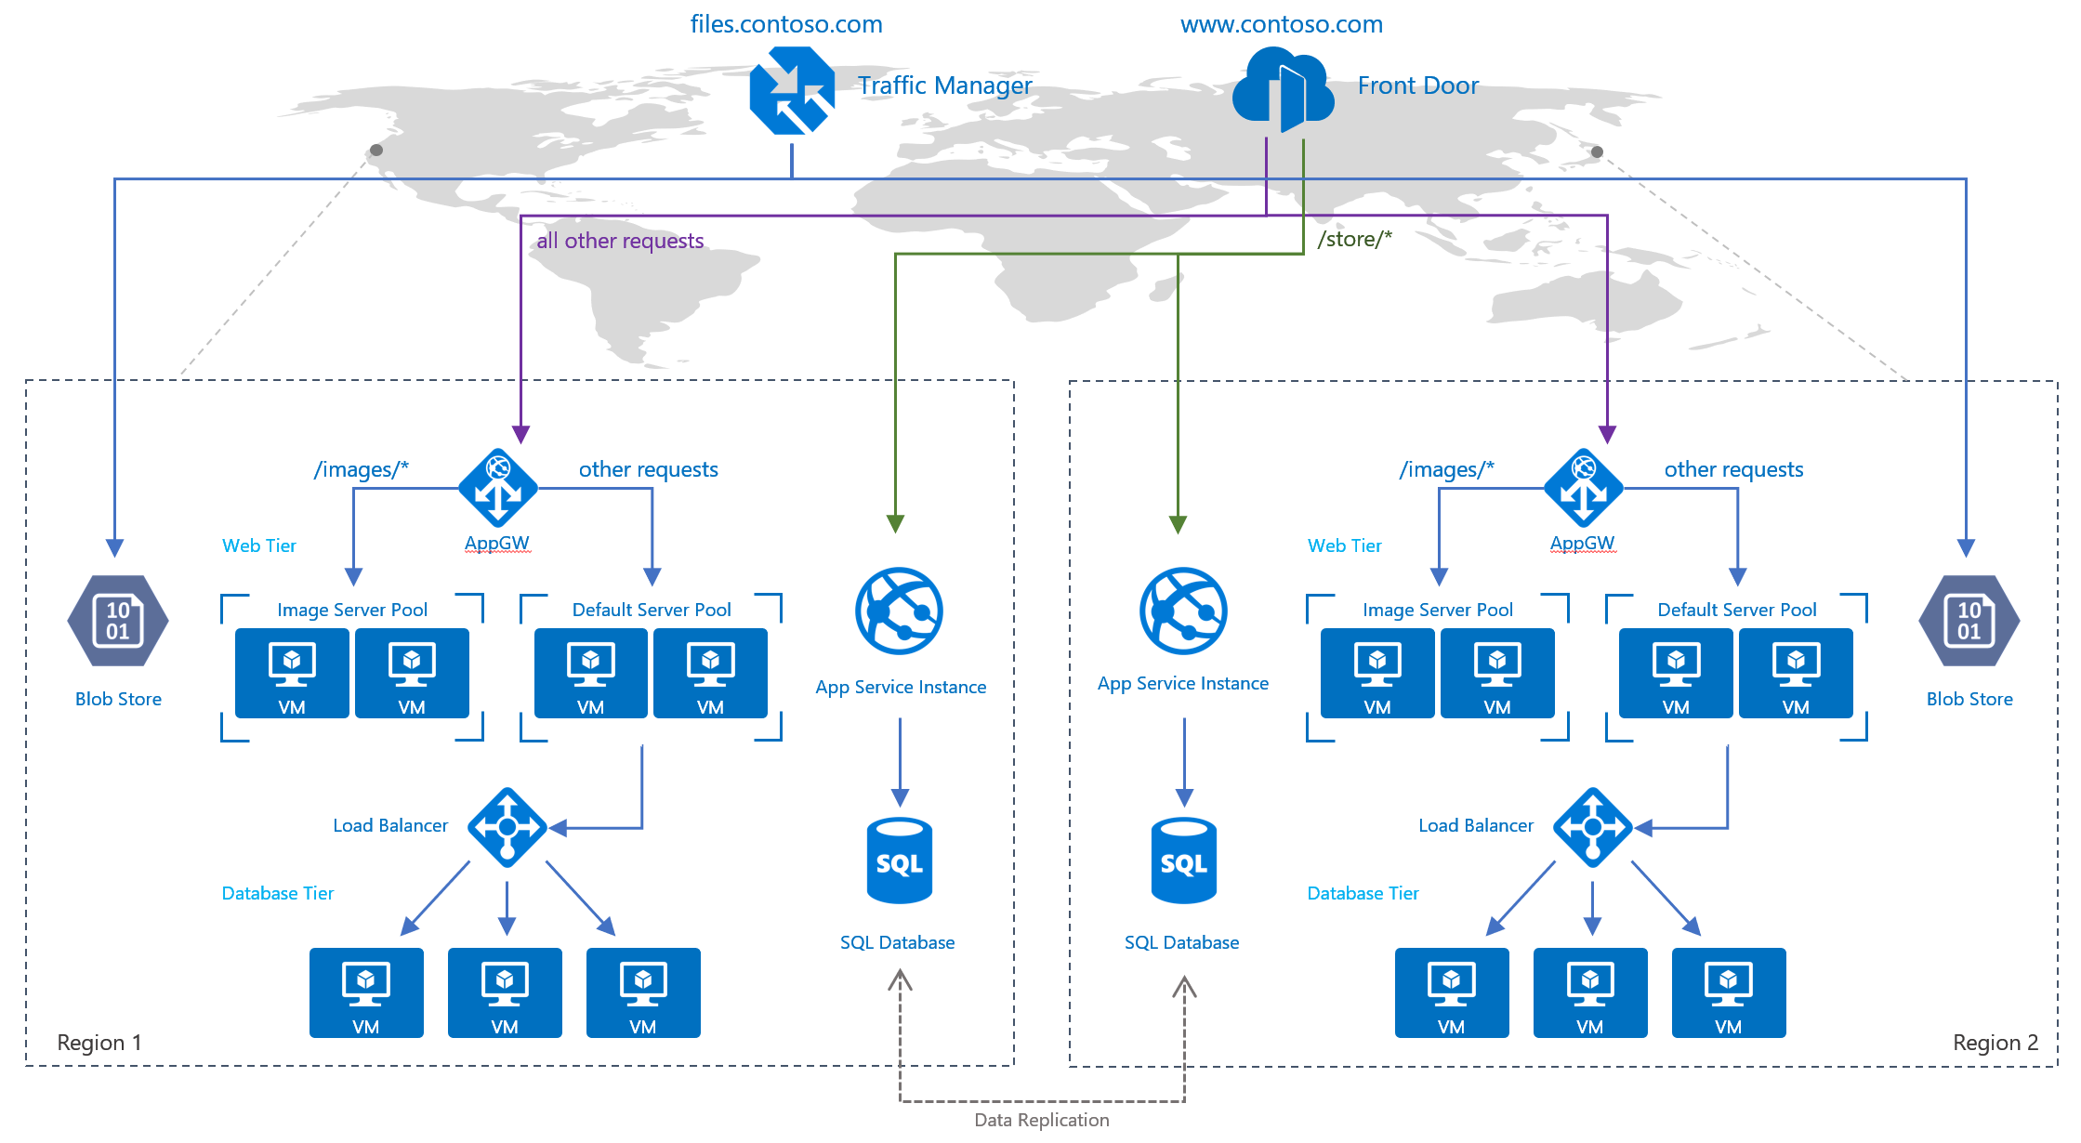
Multi-Region Architecture

Slide 11

Why?
Availability DR & Business Continuity Low Latency / Performance Capacity Data Privacy / Legal Compliance

Slide 12
SLA
SLA | Downtime per week | Downtime per month | Downtime per year
99% | 1.68 hours | 7.2 hours | 3.65 days
99.9% | 10.1 minutes | 43.2 minutes | 8.76 hours
99.95% | 5 minutes | 21.6 minutes | 4.38 hours
99.99% | 1.01 minutes | 4.32 minutes | 52.56 minutes
99.999% | 6 seconds | 25.9 seconds | 5.26 minutes

Slide 13
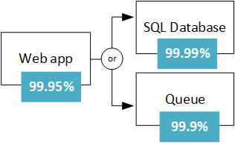
Composite SLAs
Composite SLAs involve multiple services supporting an application, each with differing levels of availability.
e.g. Web app and (database OR queue)
SLA = 99.95% × 99.99999% = ~99.95%

Slide 14
SLAs for multi-region deployments
The composite SLA for a multi-region deployment is calculated as follows:
N is the composite SLA for the application deployed in one region.
R is the number of regions where the application is deployed.
The expected chance that the application fails in all regions at the same time is ((1 − N) ^ R). For example, if the single-region SLA is 99.95%:
The combined SLA for two regions = (1 − (1 − 0.9995) ^ 2) = 99.999975%
The combined SLA for four regions = (1 − (1 − 0.9995) ^ 4) = 99.999999%

Slide 15
Architecture Approaches
Redeploy on disaster
In this approach, the application is redeployed from scratch at the time of disaster. This is appropriate for non-critical applications that don’t require a guaranteed recovery time.
Active/Passive
A secondary hosted service is created in an alternate region, and roles are deployed to guarantee minimal capacity; however, the roles don’t receive production traffic. This approach is useful for applications that have not been designed to distribute traffic across regions.
Cold / Hot Standby
Active/Active
The application is designed to receive production load in multiple regions. This approach requires substantial investment in application design, but it has significant benefits. These include low and guaranteed recovery time, continuous testing of all recovery locations, and efficient usage of capacity.

Slide 16
Virtual Machines
Azure Backup
Create application consistent cross region backups
Separate Data Disks
Changing the OS disk requires the VM to be rebuilt
Data disks can be reattached
Be aware of potential application consistency issues
Azure Site Recovery
Replicates workloads from site-to-site
Application consistent ; enables rapid return to operational state

Slide 17
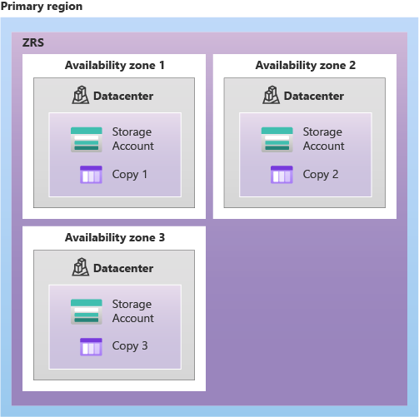
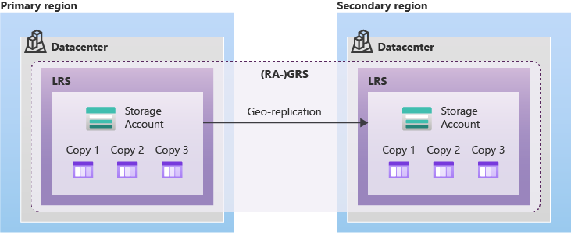
Storage
Understand GRS / LRS
Some scenarios require GRS; some might not
Fail-Over Characteristics
GRS/RA-GRS/GZRS
If your storage account is configured for read access to the secondary region, you can design your applications to seamlessly shift to reading data from the secondary if
Determining Fail Over
Azure Service Health Dashboard

Slide 18
Networking
IaC Provides best means of recovery/rebuild
Configuration / script files provide the quickest way rebuild virtual network in an alternate Azure region.
Consider On Premises / Partner connectivity
Site-to-site VPN
Network peering / UDF / NSG
Firewalls / Internal Load Balancers
ExpressRoute
DNS Resolution / Dependency

Slide 19
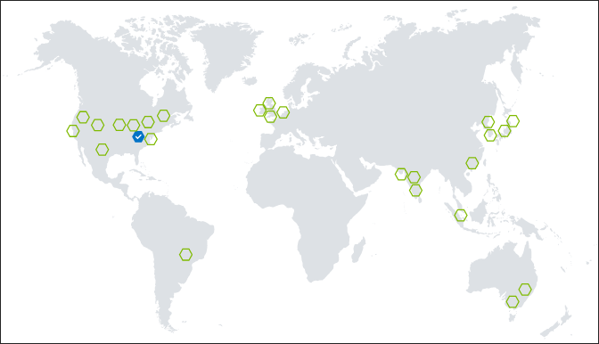
PaaS
Service Bus
Namespace in Alt. Region
App Service, AKS, Serverless
Configuration Management
IaC and CI / CD
Geo-Replication for container images (ACR)

Slide 20

















Azure Data Products and Services
Operational stores
Analytics
Governance
SQL Server
Azure SQL DB
Azure Synapse Analytics
Azure Purview
Azure SQL DB Edge
Azure
Cosmos DB
Azure HDInsight
Azure SQL Data Warehouse
Azure Data Factory
Azure Data Share
Azure for PostgreSQL
Azure for MySQL
Azure for MariaDB
Azure Data Explorer
Azure Stream Analytics
Azure Databricks
Internal Cosmos
Notes:
If we take a deeper look into our PaaS portfolio, we have over 40 services. Here we highlight the most commonly used. And the five principles I just shared are applied to each discrete service.

Slide 21


Related Best Practices
App Architecture
Stateless services
Avoid in-proc dependencies
CI/CD
Azure DevOps
Github
Infrastructure as Code
ARM, TerraForm, Pulumi
Azure
Azure Automation / runbooks
Azure Policy
Azure Blueprints
Template Specs*

Slide 22
Internet (External)
Azure edge Point of Presence “PoP”
WAN core routers
Azure ExpressRoute
Azure Front Door and CDN
Traffic to and between DCs
Microsoft Global Network (WAN)

Slide 23

Virtual Network to Virtual Network (VNet Peering)
Virtual network peering enables you to seamlessly connect two Azure virtual networks. Once peered, the virtual networks appear as one, for connectivity purposes
VNet peering
connecting VNets within the same Azure region
Global VNet peering
connecting VNets across Azure regions
After virtual networks are peered, resources in either virtual network can directly connect with resources in the peered virtual network

Slide 24







Azure Virtual WAN
Key Scenarios
Managed Hub-and-Spoke Architecture
Public (VPN) and Private (ExpressRoute) Connectivity
Global Scale
20 Gbps S2S VPN + 20 Gbps ER + 20 Gbps User VPN (P2S)
10K Users per hub
1000 sites per hub
Transit Routing
Cloud Network Orchestration
Automated large-scale branch/SDWAN CPE connectivity
Corp HQ
VNet
VNet
VNet
ExpressRoute
Region 2
Datacenter
VNet
User VPN
(Point-to-site)
Region 1
Region 3
Internet/S2S
Branch
Branch
Branch
Branch

Slide 25

What is Azure ExpressRoute?
Use Azure ExpressRoute to create private connections between Azure data centers and infrastructure on your environment. ExpressRoute connections don’t go over the public Internet, and they offer more reliability, faster speeds and lower latencies than typical Internet connections

Slide 26









ExpressRoute
Customer’s Network
Partner Edge
Primary Connection
Microsoft Edge
Secondary Connection
ExpressRoute Circuit
Microsoft Peering for Office 365, Azure public services
Azure Private Peering for Virtual Networks and private IP access to Azure public services

Slide 27

ExpressRoute site vs Azure region
Washington DC
Azure regions like East US, East US 2 are where Azure datacenters are located
Washington DC2
ExpressRoute sites like Washington DC, Washington DC2 are in a colocation facility where ER routers are deployed
East US
East US 2
VIRGINIA

Slide 28
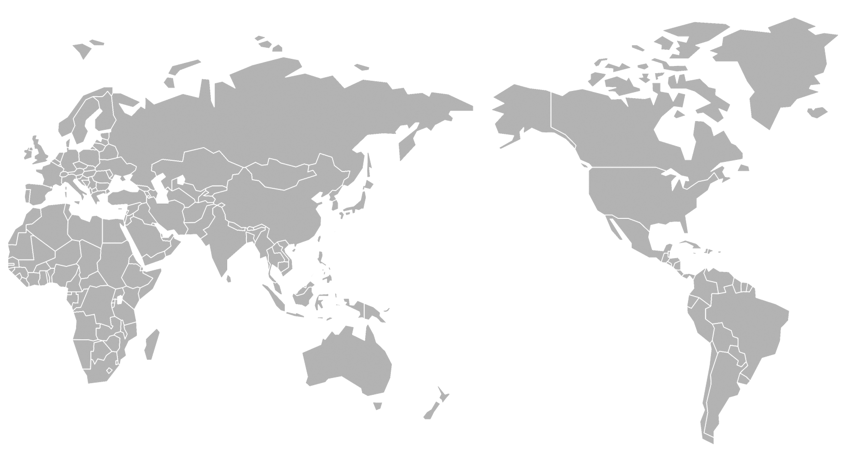
ExpressRoute Sites
New sites
Europe
Amsterdam (2)
Berlin
Copenhagen
Dublin
Frankfurt
Geneva
London (2)
Marseille
Milan
Munich
Newport, Wales
Oslo
Paris
Stavanger
Stockholm
Zurich
North America
Atlanta
Chicago
Dallas
Denver
Las Vegas
Los Angeles
Miami
Minneapolis
Montreal
New York City
Quebec City
Mexico
Phoenix
Quincy, WA
San Antonio
Seattle
Silicon Valley (2)
Toronto
Vancouver
Washington DC (2)
APAC
Bangkok
Busan
Hong Kong (2)
Jakarta
Kuala Lumpur
Osaka
Seoul
Singapore (2)
Taipei
Tokyo (2)
India & Middle East
Chennai (2)
Dubai (2)
Mumbai (2)
Oceania
Auckland
Canberra (2)
Melbourne
Perth
Sydney (2)
Africa
Cape Town
Johannesburg
South America
Bogota
Sao Paolo

Slide 29
Azure Load Balancers
Global
load balances between application stamps, endpoints, or scale-units hosted across different regions/geographies.
Regional
load balances between VMs, containers, or clusters within a region in a virtual network.
HTTP(S)
load-balancing services are Layer 7 load balancers that only accept HTTP(S) traffic. They are intended for web applications or other HTTP(S) endpoints.
Non-HTTP/S
load-balancing services can handle non-HTTP(S) traffic and are recommended for non-web workloads.

Slide 30
Azure Load Balancer Services
Service | Global/regional | Recommended traffic
Azure Front Door | Global | HTTP(S)
Traffic Manager | Global | non-HTTP(S)
Application Gateway | Regional | HTTP(S)
Azure Load Balancer | Global* | non-HTTP(S)

Slide 31
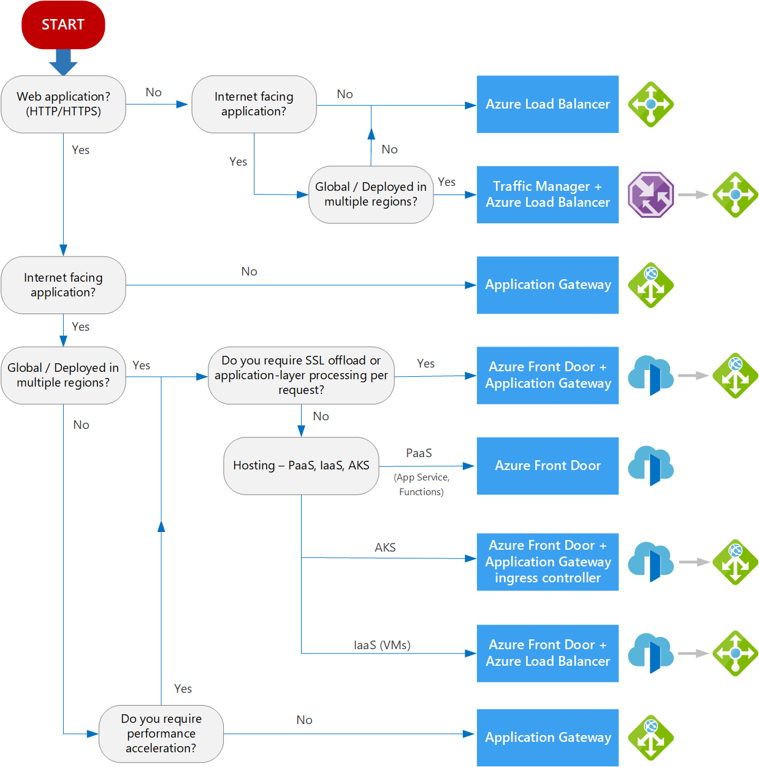
Decision tree for load balancing in Azure
Take with grain of salt
Meant to provide guidance, not final decision
Consider requirements
Evaluate SLA

Slide 32
Azure Traffic Manager
Azure Traffic Manager is a DNS-based traffic load balancer that enables you to distribute traffic optimally to services across global Azure regions
Global DNS load balancing
Automatic failover
When an endpoint goes down
Combine with hybrid applications Supports external, non-Azure endpoints so that it can be used with hybrid cloud and on-premises deployments
Distribute traffic for complex deployments Use nested Traffic Manager profiles for sophisticated, flexible rules for complex deployments

Slide 33
Traffic Routing Methods
Priority
primary service endpoint for all traffic. Weighted:
distribute traffic across a set of endpoints based on their weight
Performance
use the "closest" endpoint for the lowest network latency.
Geographic
compliance with scenarios such as data sovereignty mandates, localization of content & user experience and measuring traffic from different regions.
Multi-value
When a query is received for this profile, all healthy endpoints (more than one) are returned.
Subnet
map sets of end-user IP address ranges to a specific endpoint

Slide 34
Endpoints
Azure endpoints
used for services hosted in Azure.
External endpoints
used for IPv4/IPv6 addresses, FQDNs, or for services hosted outside Azure. Theses services can either be on-premises or with a different hosting provider.
Nested endpoints
used to combine Traffic Manager profiles to create more flexible traffic-routing schemes to support the needs of larger, more complex deployments.

Slide 35
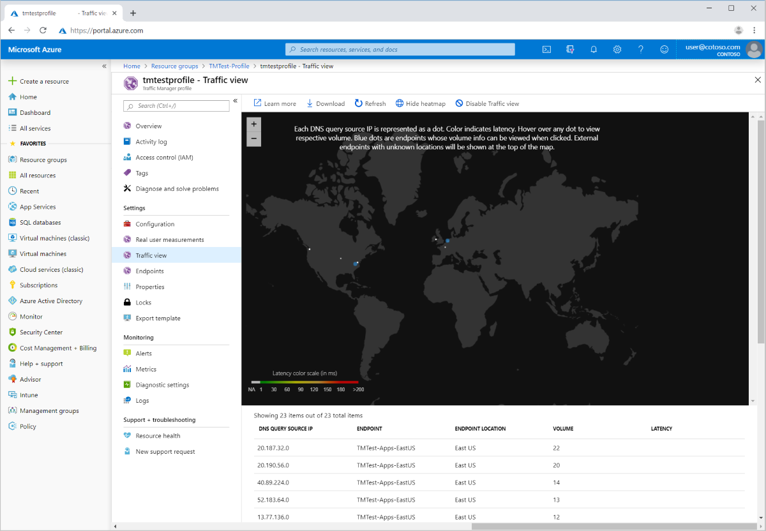
Traffic / User Info
understand where your user bases are located (up to a local DNS resolver level granularity).
view the volume of traffic (observed as DNS queries handled by Azure Traffic Manager) originating from these regions.
get insights into what is the representative latency experienced by these users.
deep dive into the specific traffic patterns from each of these user bases to Azure regions where you have endpoints.

Slide 36
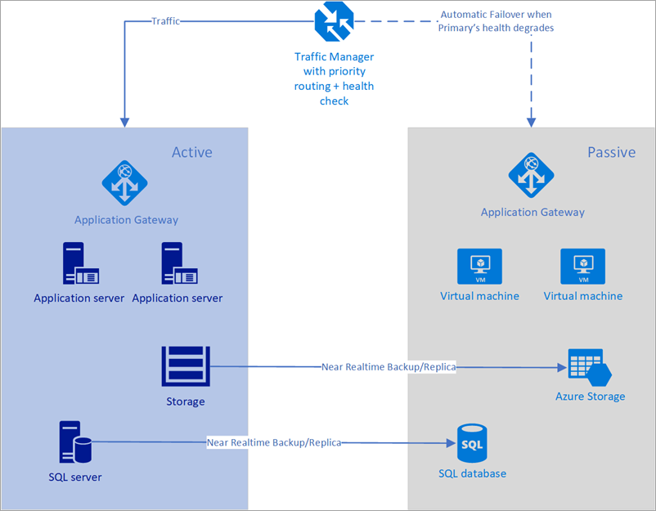
DR Operation
By default, Traffic Manager sends all traffic to the primary (highest-priority) endpoint.
If the primary endpoint appears degraded, Traffic Manager routes the traffic to the second endpoint as long as it remains healthy.

Slide 37
Azure Front Door
Azure Front Door Service provides a scalable and secure entry point for fast delivery of your global web applications
Layer 7 (HTTP/HTTPS layer) using anycast protocol with split TCP
SSL offload and application acceleration
Global HTTP load balancing with instant failover
Cookie-based session affinity.
Application Firewall and DDoS protection
Centralized traffic orchestration view

Slide 38
Routing
Latency
The latency-based routing ensures that requests are sent to the lowest latency backends acceptable within a sensitivity range. Basically, your user requests are sent to the "closest" set of backends in respect to network latency.
Priority
You can assign priorities to your backends when you want to configure a primary backend to service all traffic. The secondary backend can be a backup in case the primary backend becomes unavailable.
Weighted
You can assign weights to your backends when you want to distribute traffic across a set of backends. Whether you want to evenly distribute or according to the weight coefficients.
Session Affinity
You can configure session affinity for your frontend hosts or domains to ensure requests from the same end user gets sent to the same backend.

Slide 39

Backends/Pools
Backend
A backend refers to a web application deployment in a region
Front Door supports both Azure and non-Azure resources
Can have priority / weight assignments
Backend Pool
A backend pool in Front Door refers to the set of backends that receive similar traffic for their app.
Deployed across different regions or within the same region.

Slide 40
Health Probes
HTTP/HTTPS Based
Same port as client requests
HTTP GET, HEAD Request
Looking for 200 Response
Factors in latency
Fails to Round-Robin

Slide 41
Caching
Large File Delivery
Dynamic File Compression
1KB – 8MB
Brotli, Gzip
Configurable Caching
URL Based Caching
Multi-Layer

Slide 42
Web App Features
Rules Engine
Matching
Filter requests based on a specific IP address, country, or region, header information, mobile / desktop devices
Actions
Modify Request, Modify Response, Forward, URL Rewrite
Geo Filtering
restrict the access to your web application by countries/regions
DDoS Protection
provides defense against common network layer attacks through always-on traffic monitoring and real-time mitigation.
Protocol blocking
Capacity absorption – edge location is able to isolate malicious traffic

Slide 43
Traffic Manager or Front Door?
Traffic Manager | Front Door
Any protocol Because Traffic Manager works at the DNS layer, you can route any type of network traffic; HTTP, TCP, UDP, etc. | HTTP acceleration With Front Door traffic is proxied at the Edge of Microsoft’s network. Because of this, HTTP(S) requests see latency and throughput improvements reducing latency for SSL negotiation and using hot connections from AFD to your application.
On-premise routing With routing at a DNS layer, traffic always goes from point to point. Routing from your branch office to your on-premises datacenter can take a direct path; even on your own network using Traffic Manager. | Independent scalability Because Front Door works with the HTTP request, requests to different URL paths can be routed to different backend/regional service pools (microservices) based on rules and the health of each application microservice.
Billing format DNS-based billing scales with your users and for services with more users, plateaus to reduce cost at higher usage. | Inline security Front Door enables rules such as rate limiting and IP ACL-ing to let you protect your backends before traffic reaches your application.

Slide 44
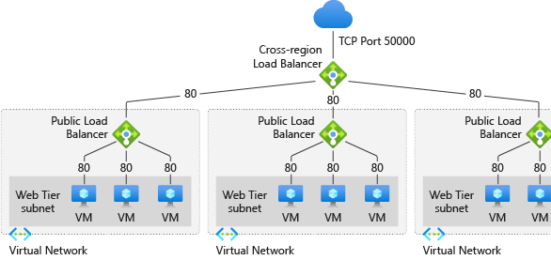
Cross-region load balancer
Incoming traffic originating from multiple regions.
Instant global failover to the next optimal regional deployment.
Load distribution across regions to the closest Azure region with ultra latency.
Ability to scale up/down behind a single endpoint.
Static IP
Client IP preservation w/ Layer-4 Pass Through
Build on existing load balancer solution with no learning curve

Slide 45
Public Load Balancer
A public Load Balancer maps the public IP address and port number of incoming traffic to the private IP address and port number of the VM.
Automatic reconfiguration Instantly reconfigures itself as you scale instance up or down
Outbound connections (SNAT) All outbound flows from private IP addresses inside your virtual network to public IP addresses on the internet can be translated to a frontend IP address of the Load Balancer
Default Distribution Mode Azure Load Balancer distributes traffic evenly amongst multiple VM instance

Slide 46
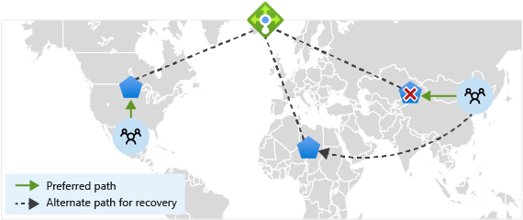
Straightforward Configuration
Configure regional redundancy by adding a global frontend public IP address to your existing load balancers.
If one region fails, the traffic is routed to the next closest healthy regional load balancer.
The health probe of the cross-region load balancer gathers information about availability every 20 seconds. If one regional load balancer drops its availability to 0, cross-region load balancer will detect the failure. The regional load balancer is then taken out of rotation.

Slide 47
Cross-region load balancer
Home Regions
East US 2
West US
West Europe
Southeast Asia
Central US
North Europe
East Asia
Participating regions
East US
West Europe
Central US
East US 2
West US
North Europe
South Central US
West US 2
UK South
Southeast Asia
North Central US
Japan East
East Asia
West Central US
Australia Southeast
Australia East
Central India

Slide 48
Current Limitations
Cross-region frontend IP configurations are public only. An internal frontend is currently not supported.
Private or internal load balancer can't be added to the backend pool of cross-regional load balancer
Cross-region IPv6 frontend IP configurations aren't supported.
A health probe can't be configured currently. A default health probe automatically collects availability information about the regional load balancer every 20 seconds.
Azure Kubernetes Service (AKS) currently cannot be integrated with Cross-region Load Balancer. Loss of connectivity should be expected when setting up a Cross-region Load Balancer in front of a Public Load Balancer deployed with AKS.

Slide 49
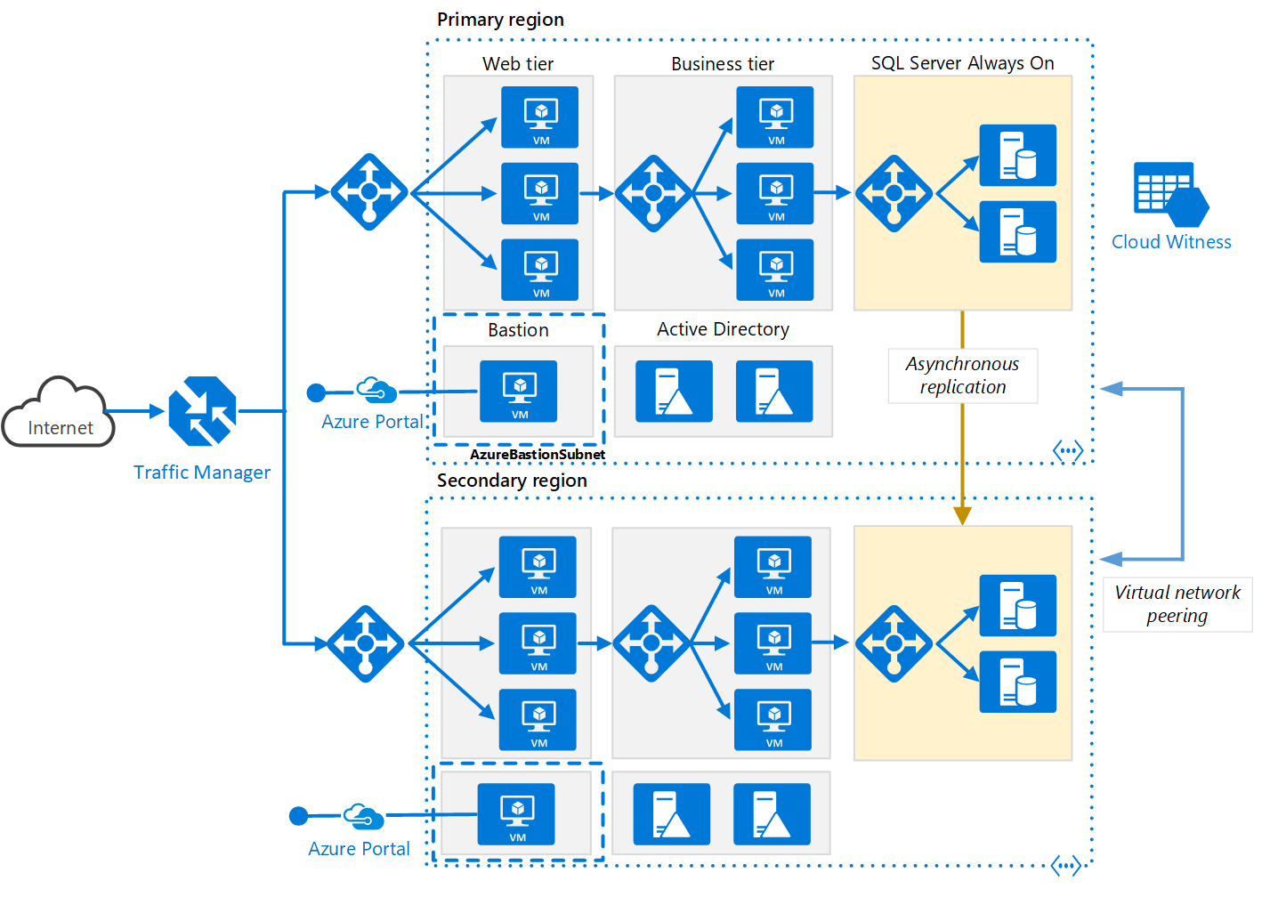
Multi-region N-tier

Slide 50

Multi-region web

Slide 51
Resources
Azure Architecture Center
Recover from a region-wide service disruption
Load Balancer Docs
Overview of Azure load-balancing options - Azure Application Architecture Guide
Azure Front Door
Azure Traffic Manager
Cross-Region Load Balancer
Learning Path:
Create an enterprise-scale architecture in Azure
Evolve your DevOps practices

